Slide 1








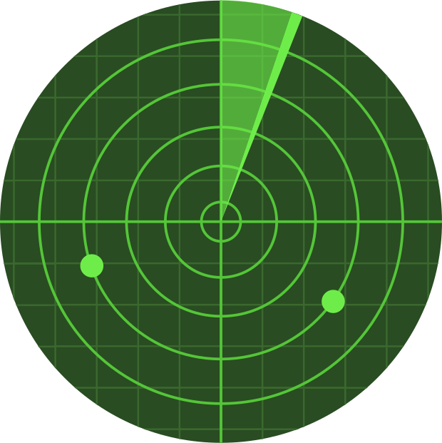
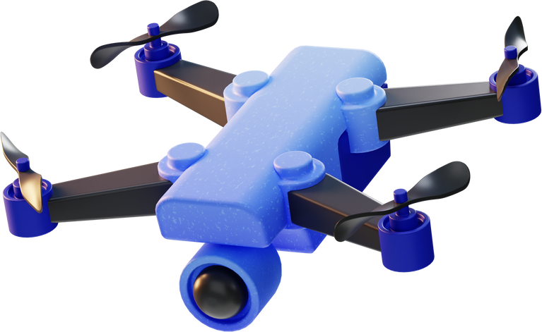
By: RoboInges
SKYWATCH
FIRE RADAR DETECTOR

Slide 2



Our solution
Establish radar in communities that detect fires in real time.
Implement the use of artificial intelligence to analyze the geography where fires occur and also determine the cause of fires through image processing
Use RPAS to determine a possible contamination in the waterways near the fire.

Slide 3


HOW DO WE PLAN TO DO IT?
rDAR for communities
We would take advantage of the benefits and scope of frequency technologies to determine if there is a fire in a certain area.
The operation would be based on emitting a wide range of different natural harmonic frequencies at which the fire vibrates, which will begin to create incidence with different objects that could reach, until then nothing will happen, but when these waves impact with the fire, they will amplify the frequency of the same and we can detect them, which will provide us with data such as the type of fuel, the magnitude of the fire and the position to find precisely the location of a fire even when it is starting to be provoked.

Slide 4
HOW?
RPAS
(Drones)
Once NASA satellites and/or the proposed radar detects fire, a swarm of autonomous drones will be sent to the coordinates provided by the satellites. Once they arrive at the site the use of the drones will be divided into 3 sections:
During their journey to the fire site, these drones will have a fire alarm, which will be on until the fire is extinguished, to inform about the fire mainly to people in the communities who do not have access to internet or electronic devices.
The swarm of drones will carry a box with the nanobots to deploy them in order to extinguish the fire, and at the end of the action of the drones they will be picked up by the drones with the box.
The drones will carry chemical equipment for water analysis, because when the fire is extinguished the drones will go to look for nearby water bodies that could be contaminated, arriving at the places the drones will take a water sample and analyze it, depending on the results the water bodies will be cataloged as contaminated or not to inform the community of their status.

Slide 5

HOW?
Nanobots
The nanobots will be deployed by means of drones, their function is to dissipate the fire, these nanobots devast the materials that are burning, as well as a perimeter to prevent the fire from spreading depending on the wind direction. The same nanobots at the end of the fire control process, they will use artificial intelligence to determine the causes of the fire, as well as the type of forest and other relevant data.
....

Slide 6
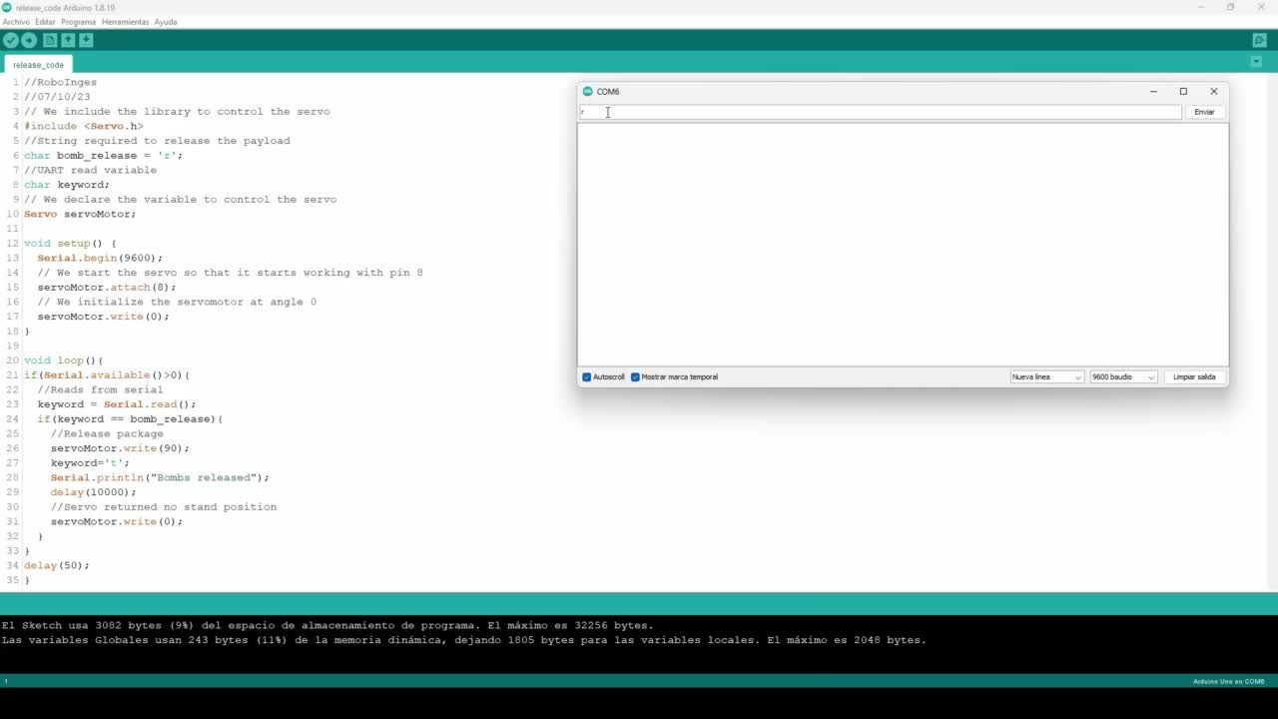
RELEASE?
Nanobots
In order to release this nanobots we simulated a release mechanism, to do this we used an Arduino UNO and a servo motor.
The moment it receives a specified message through UART, it releases the servo.

Slide 7
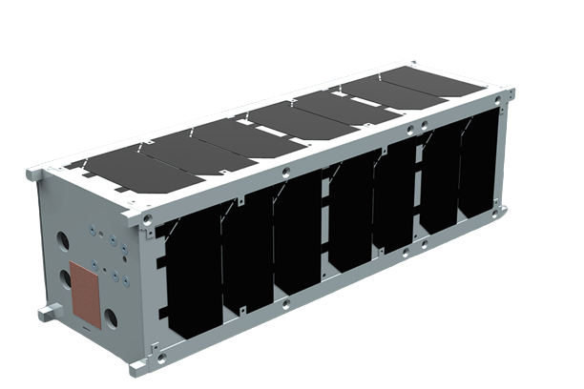
HOW?
Artificial intelligence for fire detection
Use of AI to detect fires with the help of satellite images, reducing costs per satellite, potentially allowing the deployment of swarms for more frequent updating of information. As well as reducing costs.

Slide 8
HOW?
warning communities
We will use drones with megaphones to hover over the communities near the fire to quickly warn that there is an active fire near the community.
We also propose the installation of lights in the main water intakes of the communities, to be able to inform if the water is contaminated or not, depending on the chemical analysis of the water bodies. Likewise, considering that citizens could still fetch water with buckets, motion sensors and solar-powered megaphones will be used to inform on the status of the water. In addition, for users with internet access, a telegram channel would be created, in which a bot would inform if fires were detected by satellites.

Slide 9
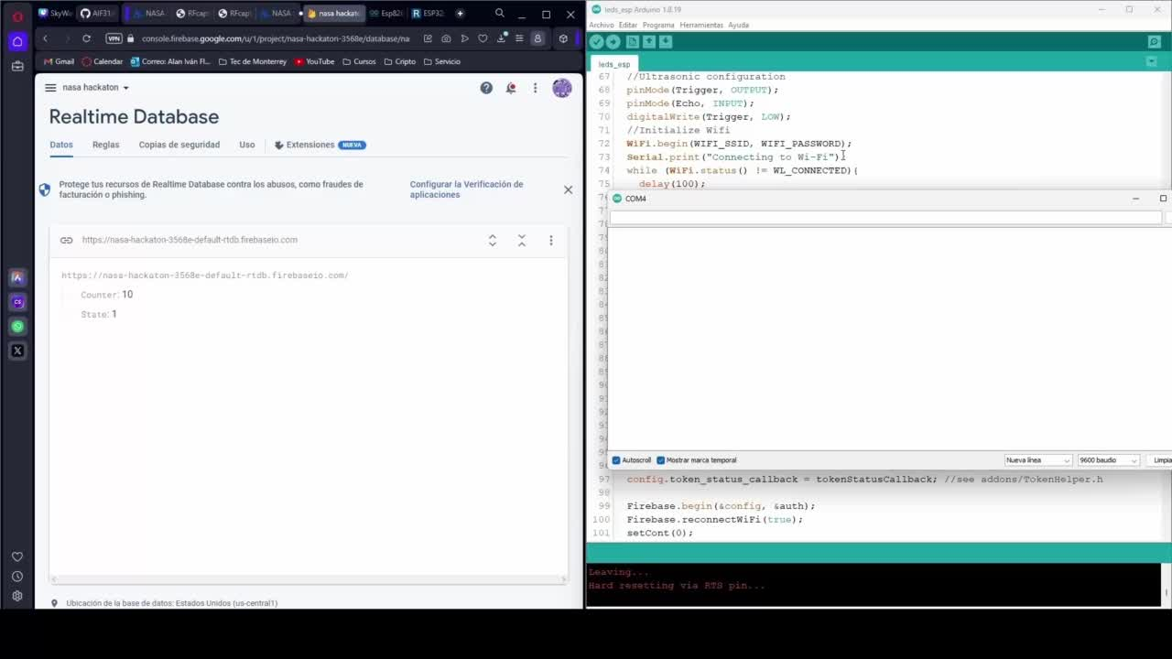
LETS SEE IT
WORKING
warning communities
A video of the operation of the community warning LEDs is shown.

Slide 10
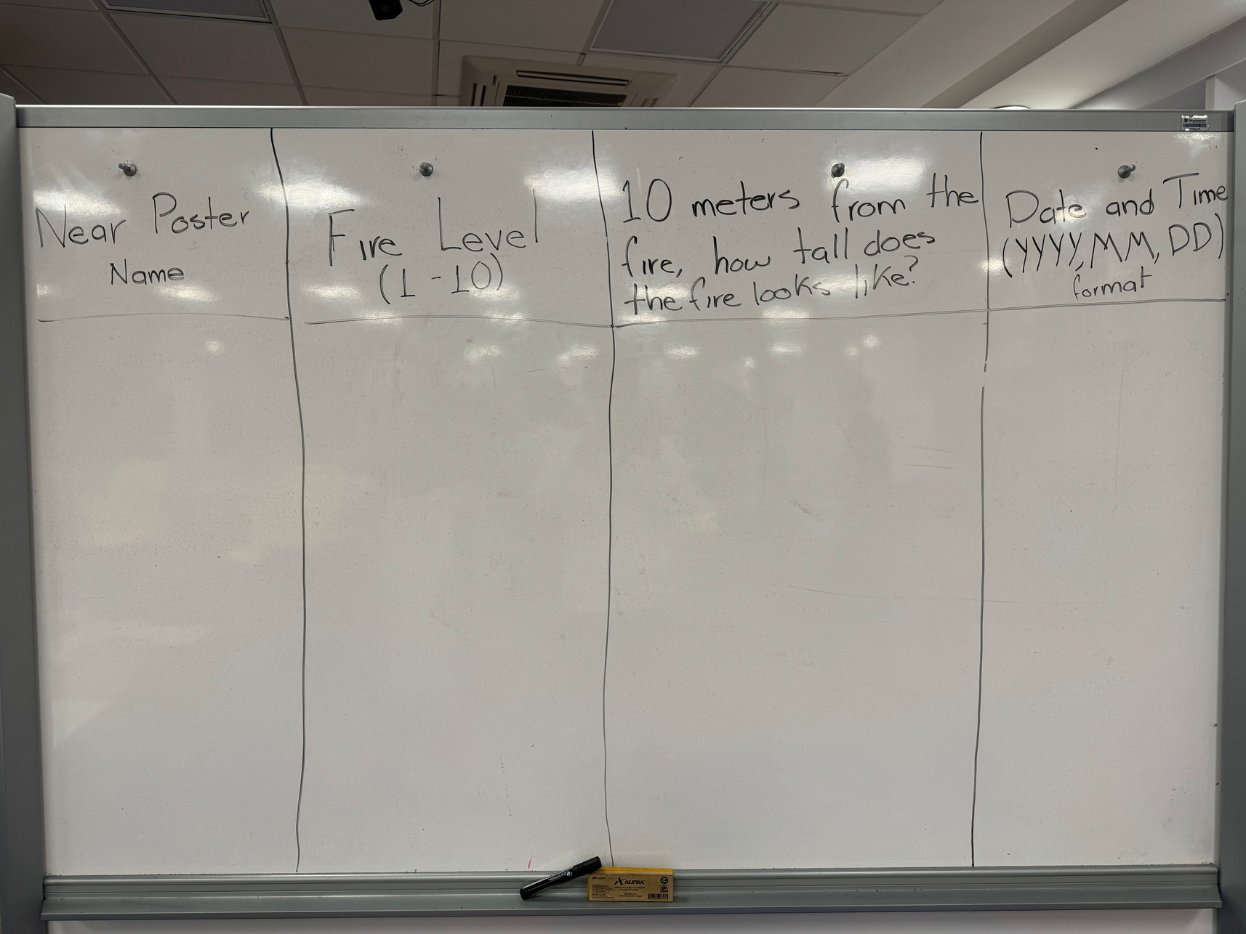
LETS SEE IT
WORKING
warning communities
We will collect data from communities without an internet connection through an image processing system where the population will write down the required information on a blackboard in a public place in their community and a drone will be in charge of analyzing and interpreting the information given.
It is planned that there will be different posts with representative names in order to know the approximate area where the fire was reported.
The required information will help us know the approximate location of the fire, the magnitude of the fire and the date and time of the report.

Slide 11
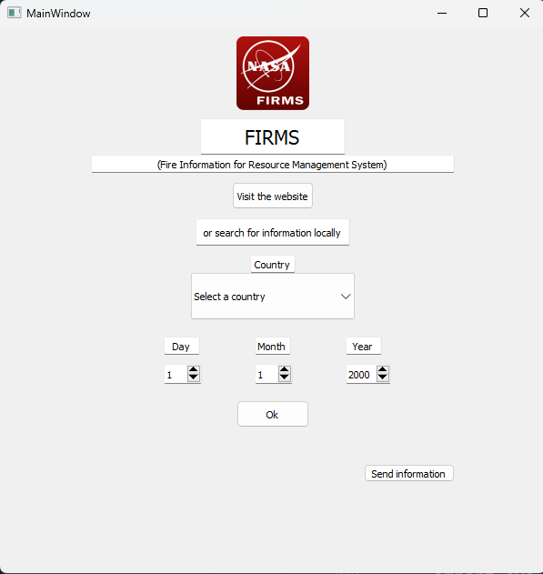
LETS SEE IT
WORKING
warning communities
Python app implementation
On the other hand, we also offer the option of searching for information within files that a drone will be in charge of providing to communities without internet. The update interval will be 3 days to ensure good knowledge of what is happening in the area.
The objective of this application is to provide easy access to the FIRMS platform so that people with internet access can view the data and filter it depending on their needs.
The objective of this application is to provide easy access to the FIRMS platform so that people with internet access can view the data and filter it depending on their needs.

Slide 12





OUR
GITHUB
https://github.com/Ulishh/Hack_NASA_RoboInges

